Slide 1
Tabletop Exercise Pandemic Influenza
Incorporating Evidence-Based Communications Best Practices
into your Agency's PHEP Protocols

Slide 2
Agenda
Welcome and Introduction (15 minutes)
Exercise (2-3 hours)
Lunch (30 minutes)
Hot Wash (1 hour)
Next Steps (15 minutes)

Slide 3
Exercise Objectives
Identify your agency’s current strengths and gaps in emergency communication and coordination
Review and list the roles, plans, and procedures related to emergency communication
Identify issues related to building effective communication channels between public health, health care, and the public, including vulnerable populations
Incorporate objectively assessed and research-validated evidence and best practices into your agency’s PHEP communications protocols.

Slide 4
Introductions
Name
Organization
Area of responsibility/role

Slide 5
Today’s exercise
Hypothetical scenario depicting a large-scale public health emergency
Facilitator will lead the participants (players) in a discussion around a series of messages in the scenario
You will examine current plans, procedures, and policies and consider best practices for disseminating emergency communications
We will conclude with a “hot wash” (debriefing) to identify strengths and gaps and effective response

Slide 6
Roles
Facilitator
Players
Table discussion leaders
Note takers
Observers
Evaluators

Slide 7
Instructions
Assume scenario is real.
Play the role of your department, agency, or community.
Consider policy issues as well as specific procedures.
Focus on identifying system gaps and strengths rather than on individual knowledge.
Take notes for the debriefing discussion.

Slide 8
Questions?

Slide 9
Exercise

Slide 10
Setting the Stage
Jefferson County, Newtopia
Largest county in state
Total population exceeds two million
Arborville is largest city in Jefferson County

Slide 11
Additional Background
Last influenza pandemic was 2009 H1N1 pandemic
Diverse population
79 percent of general adult population uses Short Message Service (SMS)

Slide 12
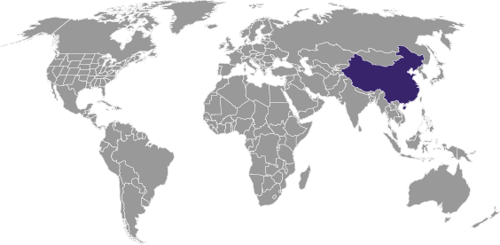
The Disease Emerges
January 5
An outbreak of severe respiratory illness emerges in rural China
More than 40 cases
20 people hospitalized
3 deaths

Slide 13
Disease Details
New cases identified
Person-to-person transmission is suspected
Viral cultures test positive for type A influenza
Strain is a new type of flu (H6N1)

Slide 14
Episode 1: Growing Awareness
February to March
WHO officials issue alerts and CDC disseminates information through the Health Alert Network (HAN)
News media around the world prominently feature this story

Slide 15
Outbreak Spreads
500 cases of H6N1 detected throughout East Asia
Fatality rates approach 5 percent
Officially branded as “pandemic” by WHO
Vaccine not ready
Antiviral drugs in limited supply
Currently no cases in the U.S.

Slide 16
United States Response
Local health departments, the Newtopia State Department of Health, and CDC are on heightened alert for signs of local outbreak
Social distancing measures are discussed at businesses and organizations
Local health agencies ask employers and schools to report increases in absenteeism

Slide 17
Messaging Questions for Episode 1
Question 1:
Public health, safety, and health care employees need information about the new outbreak.
What communication channel(s) will you use to share information with each group?
Notes:
Related research findings:
When communicating with public health workers or health care providers during emergency situations, e-mail is the number one preferred method of communication.
Workers and providers also indicated an interest in receiving Short Message Service (SMS) text messaging alerts. However, SMS programs may be limited by initial opt-in requirements and user hesitancy to sign up.
Related research findings:
Essential parts of a SMS public health message include:
Topic (alert, advisory, or event)
Recommendations (suggested responses, requested actions, and treatment instructions)
Geographic location (where is the event occurring?)
Signs and symptoms
Population(s) affected
Source (used to validate information during severe events)
Link to additional information (either a website or supporting document)
Related research findings:
Too many messages can cause conflicting information to get out or even lead to misinformation. This “noise” also has the potential to desensitize health care providers to information.
Recall rates are inversely proportional to the mean number of messages received per week; the more messages are sent, the less information is recalled.
Players should focus on how their agencies would achieve message coordination (e.g. a policy or plan).

Slide 18
Messaging Questions for Episode 1
Question 2:
Public health, safety, and health care employees need information about the new outbreak.
What specific information about this outbreak will you include in communications to each group?

Slide 19
Messaging Questions for Episode 1
Question 3:
Draft an SMS text message to communicate necessary information to health care providers.

Slide 20
Messaging Questions for Episode 1
Question 4:
What processes are in place to coordinate communications among multiple agencies? What will you do to work together to avoid information overload and improve quality of alerts?

Slide 21
Episode 2: Flu Arrives in the United States
April
April 16: First case of H6N1 is detected in Jefferson County, Newtopia
The patient arrived on a flight from China
April 18: 4 more cases are detected, 3 from the same flight
A vaccine for this strain of influenza is still not ready

Slide 22
Increasing Impact
Increased symptoms in Jefferson County
Heightened public fear about the high mortality rate associated with this strain of flu
Concerns about people seeking unnecessary care
Vital need for outreach to the general public, vulnerable populations, and limited English proficient (LEP) populations

Slide 23
Messaging Questions for Episode 2
Public health workers, health care workers, limited English proficient populations, and the general public need to be contacted about these primary cases.
What channel(s) will you use to communicate with each of these groups?
What specific information will you include in communications to each of these groups?
Notes:
Related research findings:
Information to include: topic, recommendations, geographic location, signs and symptoms, population(s) affected, source, and link to more information.
When communicating with public health workers during emergency situations, e-mail is the number one preferred method of communication.
Workers also indicated an interest in receiving Short Message Service (SMS) text messaging alerts. However, SMS programs may be limited by initial opt-in requirements and user hesitancy to sign up.
Related research findings:
Information to include: topic, recommendations, geographic location, signs and symptoms, population(s) affected, source, and link to more information.
Use media, such as e-mail and SMS text messaging, to inform the public. HIPPA requirements must be followed when sending any health information.
Community-based organizations and community networks may be willing to receive emergency-related messages. Make sure a policy is established regarding redistribution of messages during emergencies.
Related research findings:
Information to include: topic, recommendations, geographic location, signs and symptoms, population(s) affected, source, and link to more information.
When communicating with health care providers during emergency situations, e-mail is the number one preferred method of communication.
Providers also indicated an interest in receiving Short Message Service (SMS) text messaging alerts.
Related research findings:
Information to include: topic, recommendations, geographic location, signs and symptoms, population(s) affected, source, and link to more information.
Television, newspapers, community-based organizations, hospitals, and pharmacies are important methods of emergency communication with the LEP population.
Emergency services using public information call centers (PICC) and 911 calls are effective but must have LEP capabilities ahead of time (operators trained, interpreters ready, process confirmed)
SMS text messaging is preferred by deaf and hard-of-hearing populations over other technologies, with the majority being willing to receive emergency alerts.

Slide 24
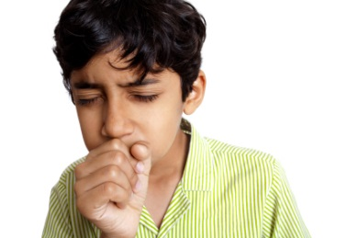
Episode 3: The Pandemic Spreads
May
49 new cases of H6N1:
31 cases reside in Arborville
18 cases live outside Arborville, but work or have visited there
2 dead

Slide 25
Additional Cases
End of May
578 cases:
200 cases reside outside the city
23 cases are health care providers and public health workers
30 dead
Cases have been concentrated in schools

Slide 26
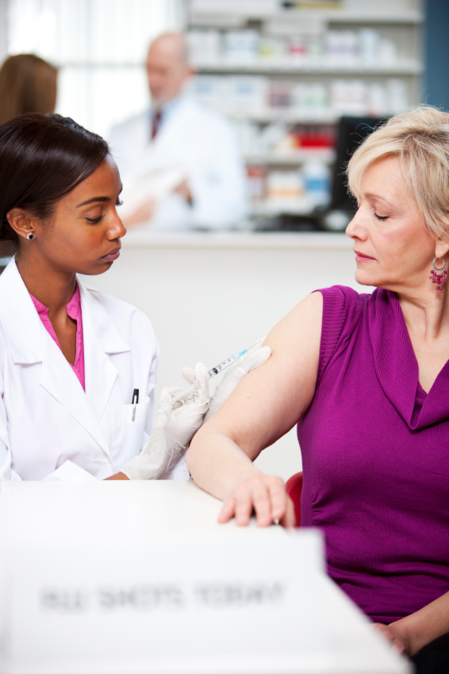
A Vaccine is Ready
June
FDA releases a vaccine
Jefferson County receives 100,000 vaccinations
Vaccines are to be given to high-priority groups first

Slide 27
Messaging Questions for Episode 3
Question 1:
Vaccine distribution is beginning. What channel(s) will you use to communicate with health care workers about high-priority groups and how to access the stockpile of vaccines?

Slide 28
Messaging Questions for Episode 3
Question 2:
Public interest in a vaccine has caused a rush of calls and visits to local doctor offices.
What information will you share with the general public to quell concerns and fears? What channel(s) will you use to distribute this information?

Slide 29
Messaging Questions for Episode 3
Question 3:
How will you reach vulnerable and limited English proficient populations? What partnerships or other community relationships could help you share information with these populations?

Slide 30
Messaging Questions for Episode 3
Question 4:
What legal issues must you consider when communicating vaccine information to the public? What processes are in place to offer legal support for emergency communications?

Slide 31
Episode 4: Vaccine Distribution
August
Shortages in practitioners and resources
Local hospitals and outpatient clinics are extremely short-staffed
Shortage of beds and equipment in intensive care units

Slide 32
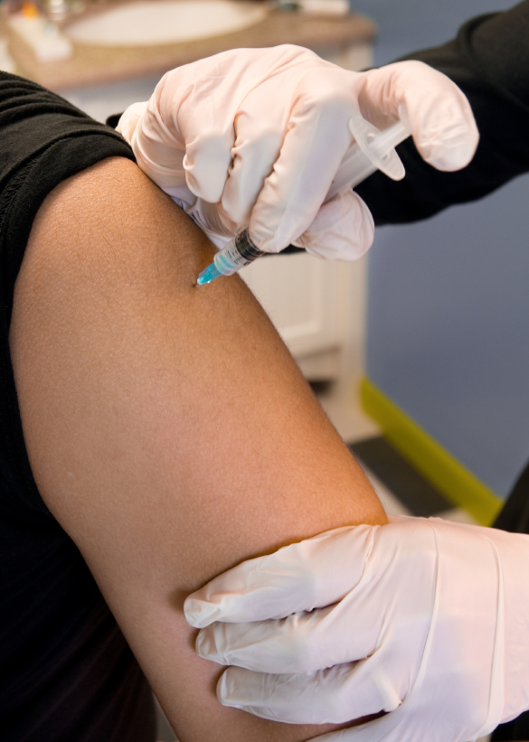
Additional Vaccine
A second batch of vaccinations becomes available
New vaccination sites are required

Slide 33
Messaging Questions for Episode 4
Question 1:
You need to mobilize the medical and public health reserve corps to provide vaccinations. How will you mobilize reserve corps members?

Slide 34
Messaging Questions for Episode 4
Question 2:
How will you provide public health workers and health care providers informed with time-sensitive, up-to-date information about additional vaccine supplies and distribution sites?

Slide 35
Messaging Questions for Episode 4
Question 3
How will you inform the public about wait times due to shortage of staff? When new vaccination sites are operational, how will you communicate that information to the public?

Slide 36
Episode 5: Recovery and Planning
September
Pandemic appears to be controlled
Decrease in the prevalence of H6N1 in Jefferson County
Need to prepare for additional cases and surges in H6N1 prevalence

Slide 37
Messaging Questions for Episode 5
Question 1:
Little time remains between now and when the regular influenza season starts. What messages should you communicate to the public at this time?

Slide 38
Messaging Questions for Episode 5
Question 2:
How will you solicit feedback from health care providers, public health workers, and employers involved in the response in order to evaluate your communicate efforts?

Slide 39
Lunch

Slide 40
Hot Wash

Slide 41
Hot Wash Instructions
Return to your assigned place at the table.
Table discussion:
Identify the 1-3 most important activities accomplished during this tabletop exercise.
What are the 1-3 most important gaps identified during this exercise?
Report out
Table discussion
What strategies/actions will you take to resolve the gaps or issues you found during this exercise?
What are the most important lessons learned from participating in this exercise?
Report out and full-group discussion

Slide 42
Next Steps
AAR (After Action Report)
Exercise evaluation
Final comments
Adjourn

Slide 43
Acknowledgements
NWPERRC Primary and Co-Investigators, Researchers, and Staff Mark Oberle, MD, MPH, Principal Investigator
Susan Allan, MD, MPH Janet Baseman, PhD, MPH Sharon Bogan, MPH Paul Bugni Becca Calhoun, MPH Jeff Duchin, MD Steven Helgerson, MD, MPH Hilary Karasz, PhD Siri Kushner, MPH Meredith Li-Vollmer, PhD Dorothy MacEachern, MPH | Hendrika Meischke, PhD Randall Nett, MD, MPH Ian Painter, PhD Shin-Ping Tu, MD, MPH Debra Revere, MLIS, MA Andy Stergachis, PhD, RPh Hanne Thiede, MPH, DVM Anne Turner, MD, MLIS, MPH Ruth Westergaard, MPH Mei-Po Yip, MPhil, PhD Northwest Preparedness and Response Learning Center

